Slide 1
Introduction to Computer Programming Lecture 1.3:
Introduction to Sypder
Hemma Philamore
Department of Engineering Mathematics

Slide 2

What is Spyder?
PyCharm is an Integrated Development Environment (IDE)
An IDE is a suite of tools used to write programs:
A code editor
Syntax highlighting
Code autocomplete
Highlighting of code errors/warnings, and hints on how to fix them
Automated build tools:
build/run programs within the editor
display output
display variables and values
More advanced tools e.g. debuggers

Slide 3
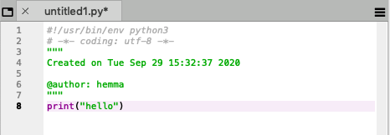
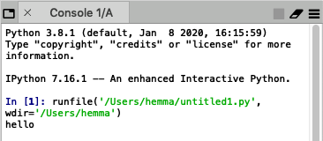
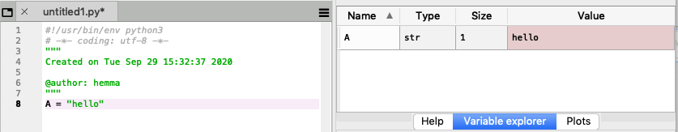
Why Spyder?
Python console built into the editor
Write code
View program output
List of variables in program

Slide 4
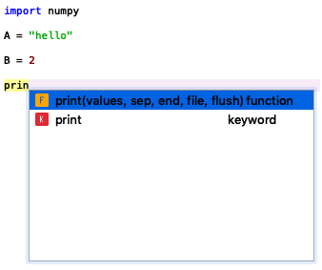
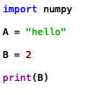
Why Spyder?
Syntax highlighting
Code suggestions
keyword
text data
number data
functions

Slide 5
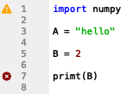
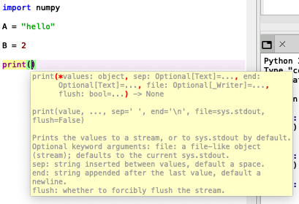



Why Spyder?
Quick access to python documentation
Highlighting of code errors/warnings
warning
error
Hover curser to see error

Slide 6
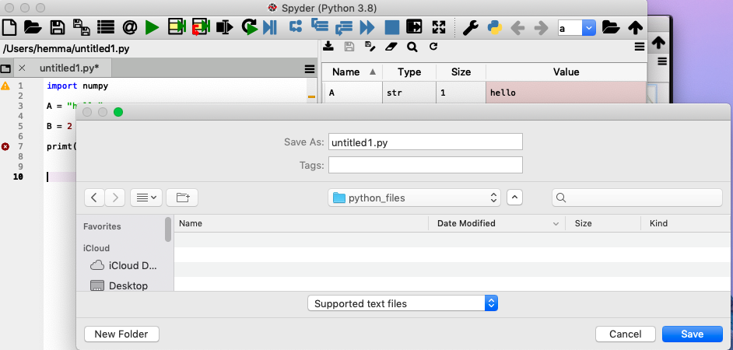
Saving a file
save
.py file extension

Slide 7
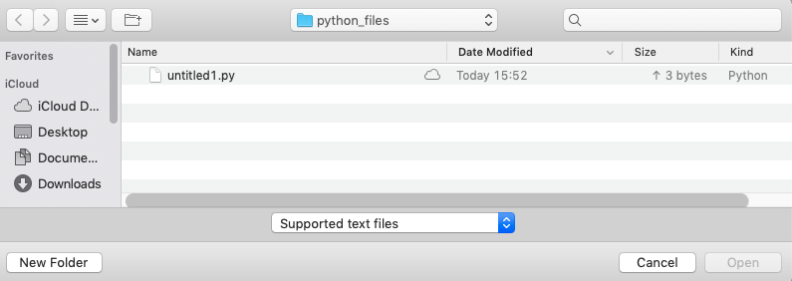

Opening a .py file
Open Spyder
Open
Select file

Slide 8
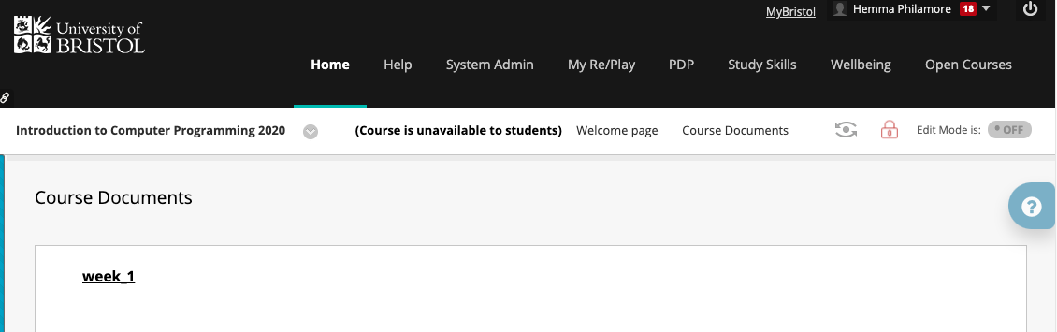

Practice Exercises
Navigate to the Introduction to Computer Programming 2020 page on Blackboard
Select: Course Documents
Select: week 1
Select: exercises week 1

Slide 9
Practice Exercises
Take any problems you have to the online drop-in sessions, every Wednesday
Live support from helpful, friendly teaching assistants by video chat
Bring your solution to the exercises to the group tutorial, every Friday
These are compulsory!
Attendance will be recorded

